Slide 1
Course
AWS Cloud Practitioner
MaxCloud

Slide 2
03
Class
Amazon RDS
Amazon Aurora
AWS DMS
AWS SCT

Slide 3
AWS DMS
AWS Database Migration Service (AWS DMS) is a cloud service that makes it possible to migrate relational databases, data warehouses, NoSQL databases, and other types of data stores.
You can use AWS DMS to migrate your data into the AWS Cloud or between combinations of cloud and on-premises setups.

Slide 4
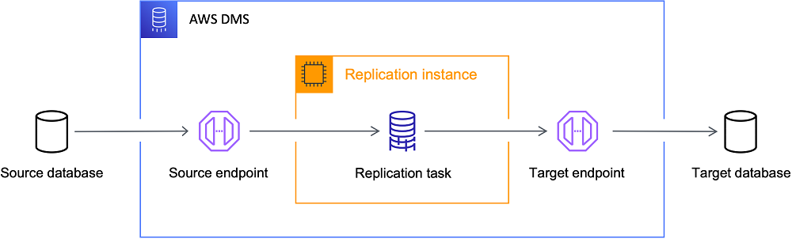
Target endpoint

Slide 5
Task types
Migrating data to the target database - Full Load
Capturing changes during migration - full-load-and-cdc
Replicating only data changes on the source database - cdc

Slide 6
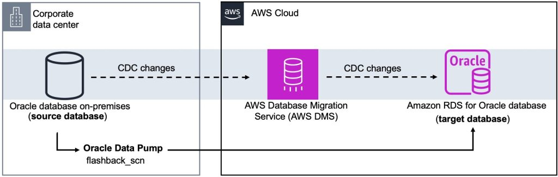
On-premise to cloud

Slide 7
AWS Schema Convertion tool (AWS SCT)
You can use the AWS Schema Conversion Tool (AWS SCT) to convert your existing database schema from one database engine to another.
You can convert relational OLTP schema, or data warehouse schema. Your converted schema is suitable for an Amazon Relational Database Service (Amazon RDS) MySQL, MariaDB, Oracle, SQL Server, PostgreSQL DB, an Amazon Aurora DB cluster, or an Amazon Redshift cluster.

Slide 8
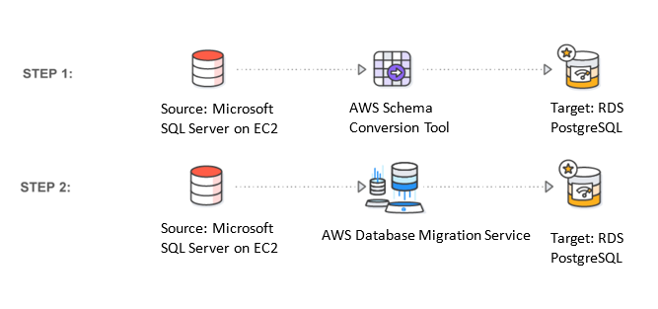
AWS Schema Convertion tool (AWS SCT)
https://aws.amazon.com/blogs/database/cross-engine-database-replication-using-aws-schema-
conversion-tool-and-aws-database-migration-service/

Slide 9
Muchas Gracias

